Slide 1


Predictive Policing
Prepared by:
April Love Naviza
Vimitaben Vaidya
Wisanu Boonrat
Date: 23-July-2020

Slide 2





Introduction
April Love Naviza
Project Management Roles
Sprint 1: Scrum Master
Project Manager
Sprint 2: Project Manager
Manage product backlog and Jira tickets
Be responsible for the assigned Jira tickets.
Sprint 3: Developer
Sprint 4: Scrum Master
Scrum Master
Set and facilitate weekly meeting
Prepare weekly report
Communicate concerns and issues
Vimitaben Vaidya
Sprint 1: Developer
Sprint 2: Scrum Master
Sprint 3: Project Manager
Developer
Sprint 4: Developer
Research and develop the prototype and final product in both data modelling and UI.
Wisanu Boonrat
Sprint 1: Project Manager
Sprint 2: Developer
Farhad Mehdipour
Sprint 3: Scrum Master
Sprint 4: Project Manager
Supervisor / Product Owner
Declare the goal and objective
Guide the project in the correct direction
Review and feedback

Slide 3
Agenda
Objective
Project Management and Development Tools (Jira & Trello)
Data Science Life Cycle
Acquired Dataset and Descriptive Analysis
Algorithms
Baseline Result
Feature Engineering & Data Transformation
New Zealand Dataset Baseline
Risk Computation
Predictive Modelling
Application: User Interface
Future Work

Slide 4


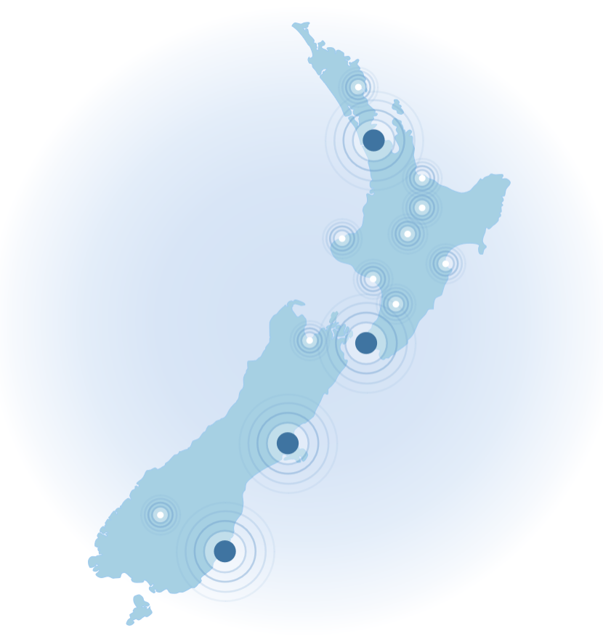


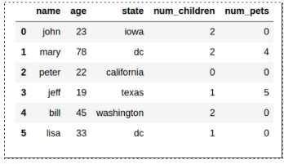
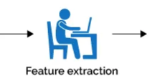
Crime Risk Prediction
Train the Machine Learning Model
Result Visualization
Predict the Crime risk in New Zealand
Supervised Machine Learning
is the process of teaching a computer system how to make accurate predictions using historical data
Algorithms
Logistic Regression
Naïve Bayes
Decision Tree Classifier
Random Forest Classifier
XGBoost
Notes:
https://www.zdnet.com/article/what-is-machine-learning-everything-you-need-to-know/
Time: 2 mins
About Predictive Policing – crime risk prediction
Objective
Demo of our tools

Slide 5











Project Management and Development Tools
Notes:
Time: 3 mins
Jira – Roles, Agile Methodology, Milestone
PowerBI
Why did we use this tools? Bitbucket
Take away – visibility of our tasks, codes, identify our backlogs
Python Language
Pycharm – scientific view /
Colab for DL

Slide 6
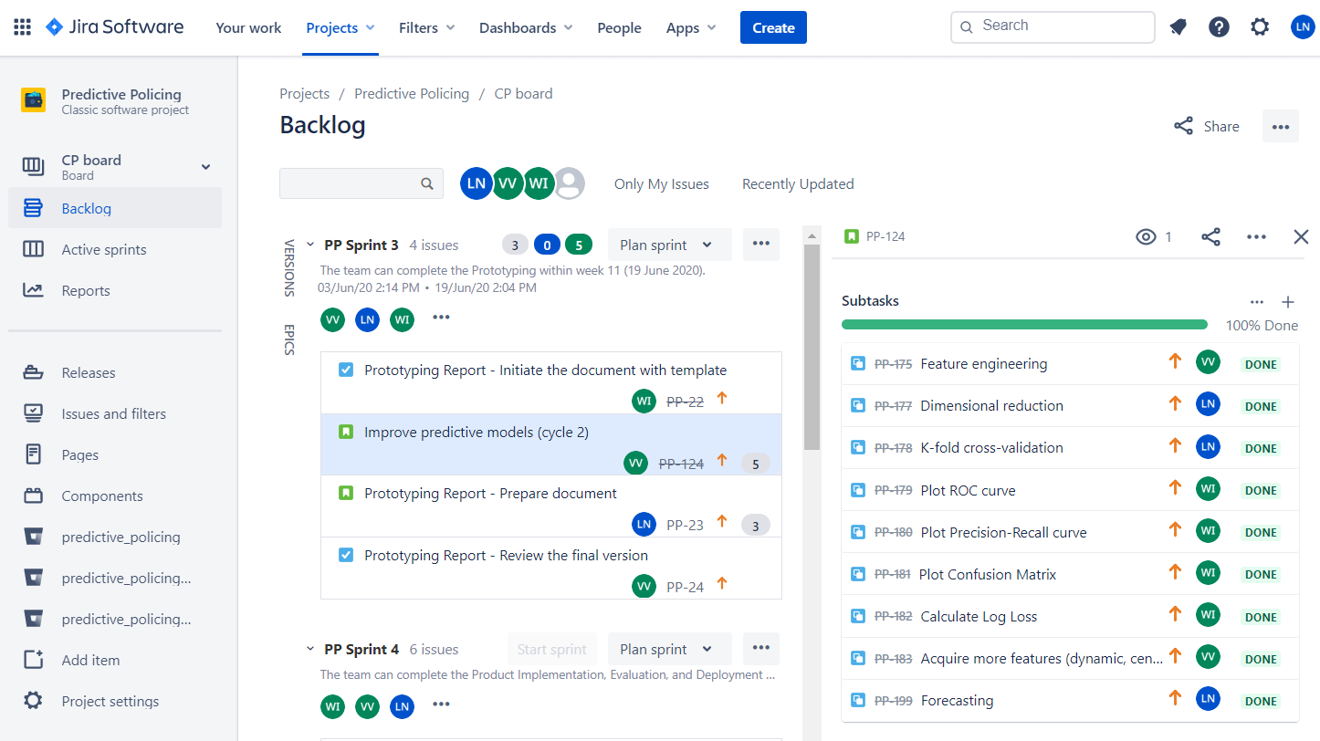
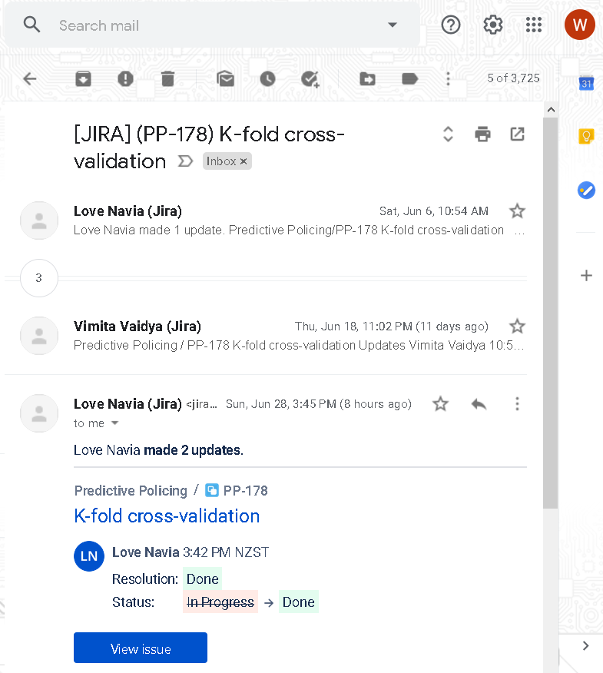
Sprint Management Identify and monitor Story and subtask in the Backlog
1
2
Task Management Identify the assignee in the Story and Subtask
Requirement Management Identify the task’s background detail and description
3
4
Changes Management Track the code changes of the story.
5
Time Tracking Log the time spent on the task.
6
Task-Updated Notification
Notes:
How it works for our Team
How’s our experience
Advantages or Benefits

Slide 7
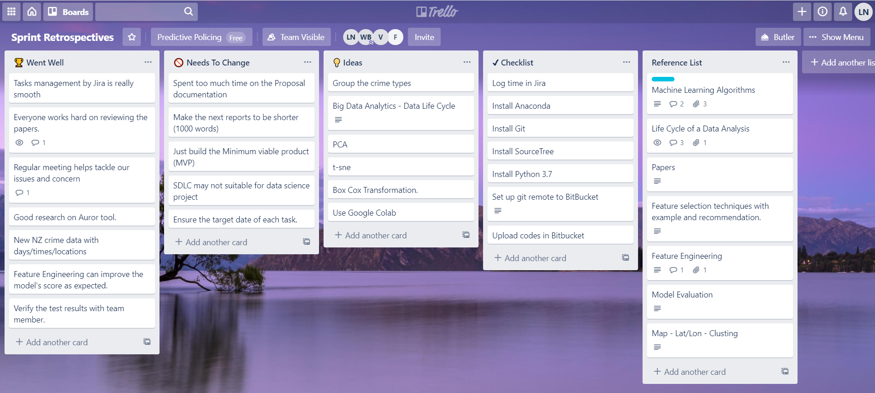
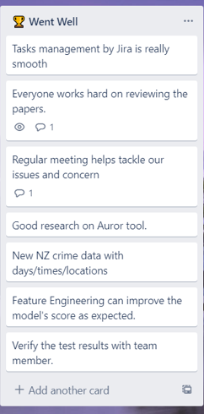
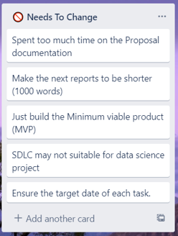
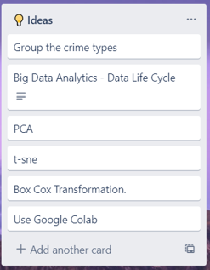
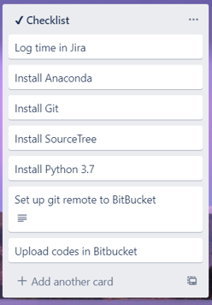
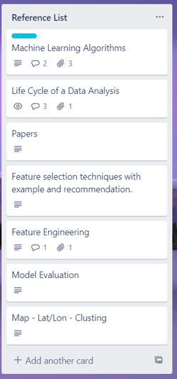
Notes:
Collaboration Tool

Slide 8
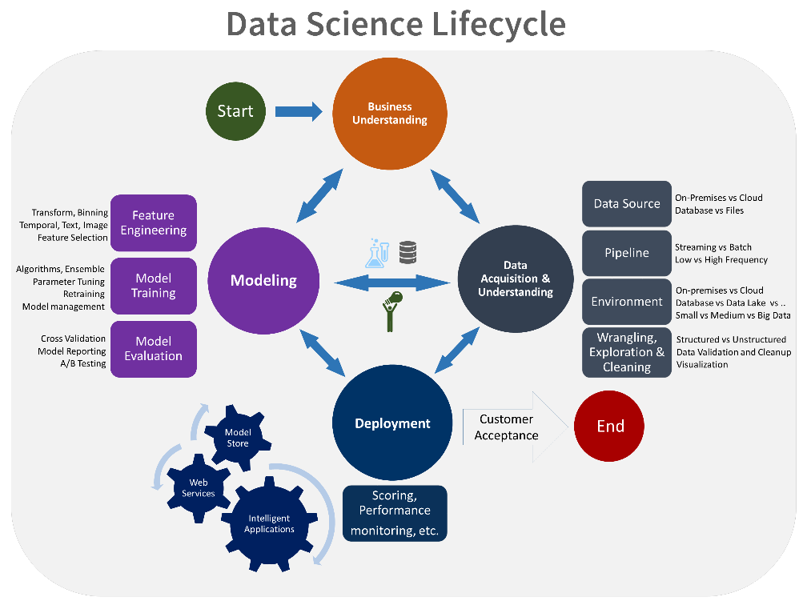

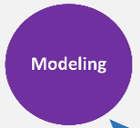
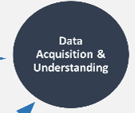
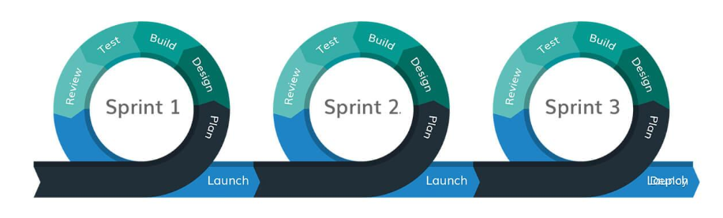
Agile Methodology
Notes:
Love
Time: 5 mins
Scope of support of this project – in relation to our objective we only focus on the 3 areas
BU - team meeting with Farhad to know the business requirements, objectives and had team agreement. Weekly meeting with Farhad
DA – initially acquired 6 datasets (Boston, Denver, London, SF and NZ). Each have different patterns and features.
Model – we did Feature Selection and Feature Engineering. Applied different algorithms.
Deployment – created a simple UI to visualize our Model result

Slide 9
About the 6 dataset
Boston | Denver | London | San Francisco | New Zealand (1) | New Zealand (2) (nz_victim_timeplace.csv)
INCIDENT_NUMBER | INCIDENT_ID​ | lsoa_code​ | IncidntNum​ | Age Group 5Yr Band | ANZSOC Division​
OFFENSE_CODE​ | OFFENSE_ID​ | borough​ | Category​ | ANZSOC Division​ | ANZSOC Group​
OFFENSE_CODE_GROUP​ | OFFENSE_CODE​ | major_category​ | Descript​ | ANZSOC Group​ | ANZSOC Subdivision​
OFFENSE_DESCRIPTION​ | OFFENSE_CODE_EXTENSION​ | minor_category​ | DayOfWeek​ | ANZSOC Subdivision​ | Area Unit​
DISTRICT​ | OFFENSE_TYPE_ID​ | value​ | Date​ | Person/Organisation​ | Table 1​
REPORTING_AREA​ | OFFENSE_CATEGORY_ID​ | year​ | Time​ | Table 1​ | Location Type​
SHOOTING​ | FIRST_OCCURRENCE_DATE​ | month​ | PdDistrict​ | Selected Period​ | Locn Type Division​
OCCURRED_ON_DATE​ | LAST_OCCURRENCE_DATE​ | ​ | Resolution​ | Previous Period​ | Meshblock​
YEAR​ | REPORTED_DATE​ | ​ | Address​ | Age Group​ | Number of Records​
MONTH​ | INCIDENT_ADDRESS​ | ​ | X​ | % Variance​ | Occurrence Day Of Week​
DAY_OF_WEEK​ | GEO_X​ | ​ | Y​ | Ethnicity​ | Occurrence Hour Of Day​
HOUR​ | GEO_Y​ | ​ | Location​ | Ethnic Group​ | Territorial Authority​
UCR_PART​ | GEO_LON​ | ​ | PdId​ | Months Ago​ | Victimisations​
STREET​ | GEO_LAT​ |  |  | Mop Division​ | Weapon​
Lat​ | DISTRICT_ID​ |  |  | Mop Group​ | Year Month​
Long​ | PRECINCT_ID​ |  |  | Mop Subdivision​ | Year Month (copy 2)​
Location​ | NEIGHBORHOOD_ID​ |  |  | Method of Proceeding​ | Month Year​
 | IS_CRIME​ |  |  | Number of Records​
 | IS_TRAFFIC​ |  |  | Police Area​
 | ​ |  |  | Police District​
 |  |  |  | Proceedings​
 |  |  |  | Year Month​
 |  |  |  | Ytd Month​
Notes:
About the 6 dataset

Slide 10
Descriptive Analysis
Datasets | # of Records | # of Columns | # of Crime Types | Has Date | Has Time | Has Location
Boston | 319,074 | 17 | 66 | Y | Y | Y
Denver | 466,841 | 19 | 15 | Y | Y | Y
London | 13,490,605 | 7 | 9 | year|month | N | Y
San Francisco | 150,501 | 13 | 39 | Y | Y | Y
New Zealand (1) (16 csv files) | 641,641 | 23 | 16 | year|month | N | Y
New Zealand (2) (nz_victim_timeplace.csv) | 1,194,764 | 17 | 6 | Y | Y | Y

Slide 11
Which algorithm is best ?

Slide 12
Baseline Results: Variables
Datasets | Feature Variables | Target Variable
Boston | MONTH, DAY_OF_WEEK, HOUR, DISTRICT, REPORTING_AREA, STREET | OFFENSE_CODE_GROUP
Denver | MONTH, DAY_OF_WEEK, HOUR, DISTRICT_ID, PRECINCT_ID | OFFENSE_CATEGORY_ID
London | borough, month | major_category
San Francisco | MONTH, DAY_OF_WEEK, HOUR, PdDistrict, Address | Category
New Zealand (1) (16 csv files) | MONTH, Age Group 5Yr Band, Ethnicity, Police District | ANZSOC Division
New Zealand (2) (nz_victim_timeplace.csv) | MONTH, DAY_OF_WEEK, HOUR, Area Unit, Territorial Authority | ANZSOC Division
Notes:
Should we mention about the prototype that we did for predicting crime type
Include result of ML and DL
Table format

Slide 13
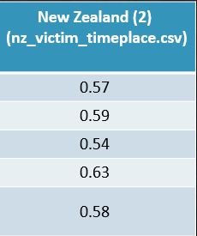
Baseline Results
Algorithms | Boston | Denver | London | San Francisco | New Zealand (1) | New Zealand (2) (nz_victim_timeplace.csv)
LogisticRegression | 0.12 | 0.26 | 0.29 | 0.27 | 0.16 | 0.57
GaussianNB | 0.12 | 0.28 | 0.29 | 0.27 | 0.16 | 0.59
DecisionTreeClassifier | 0.12 | 0.33 | 0.29 | 0.24 | 0.10 | 0.54
XGBClassifier | 0.19 | 0.40 | - | 0.31 | 0.18 | 0.63
RandomForestClassifier | 0.14 | 0.36 | 0.29 | 0.28 | 0.08 | 0.58
Notes:
Should we mention about the prototype that we did for predicting crime type
Include result of ML and DL
Table format

Slide 14
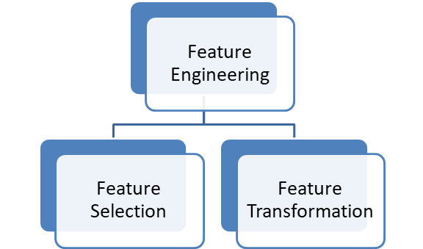
Feature Engineering
Feature engineering is the process of using domain knowledge of the data to transform existing features or to create new variables from existing ones, for use in machine learning.
Notes:
Vimi
Time: 6 mins
Explain the Features
Why we choose
Rename Columns
Drop Unused Columns
Drop Invalid Area Unit
Extract Month and Year
Impute Day of Week
Convert Day of Week to Day Index
Impute Hour of Day
Generate the Crime Factors
Group the weapon type
Convert Month to Quarter
Convert Hour to Partition

Slide 15
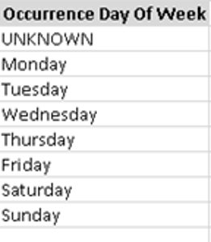
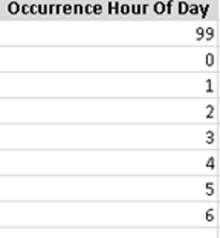
Data Transformation
376,155
547,297

Slide 16
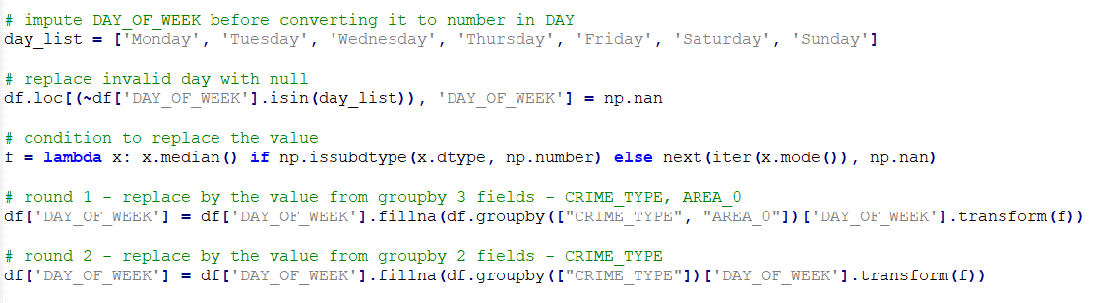
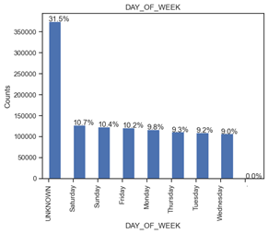
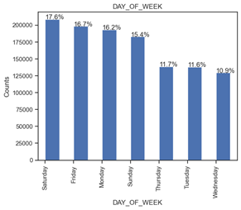
Impute Day of Week

Slide 17
NZ Dataset Baseline
Feature vars. >>> | MONTH DAY HOUR AREA_0 AREA_1 MESHBLOCK |  | MONTH DAY HOUR AREA_0 AREA_1 QUARTER HOUR_PARTITION WEAPON_TYPE
Target vars. >>> | CRIME_TYPE
 | Baseline |  | Train=70/Test=30 Cycle 1
algorithm | accuracy | log_loss | accuracy | log_loss
LogisticRegression | 0.57 | 0.97 | 0.59 | 0.87
GaussianNB | 0.59 | 0.98 | 0.59 | 4.41
DecisionTree | 0.54 | 14.23 | 0.56 | 13.10
XGBoost | 0.63 | 0.85 | 0.65 | 0.76
RandomForest | 0.58 | 4.08 | 0.58 | 3.68
Notes:
Love
Time: 2 mins
Compare results
Mention that we encountered overfitting

Slide 18
Risk Computation
How to calculate?
Ratio
Crime Factors
Stats. Numbers
Risk Level
Rank
Notes:
Wisanu
How to calculate the risk level?

Slide 19
Risk Computation
Crime Factors
Time
Month
Day
Location
Area Unit
Meshblock
Crime Type
Hour
Territorial Authority
The crime factors?
Notes:
Wisanu

Slide 20
Risk Computation
States Numbers...
Counting the crime records grouped by the crime factors
Month
Day
Territorial Authority
Area Unit
Crime Type
MONTH_AREA_CRIME_COUNT
DAY_AREA_CRIME_COUNT
MONTH_AREA_CRIME_TYPE_COUNT
We have 3 numbers....
Q. How can we build the relationship among those numbers?

Slide 21
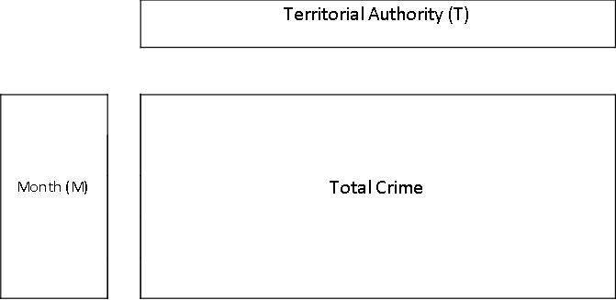
Risk Computation
MONTH_AREA_CRIME_COUNT
df.groupby(['MONTH', 'AREA_1']).size().to_frame('MONTH_AREA_CRIME_COUNT')
Notes:
Wisanu

Slide 22
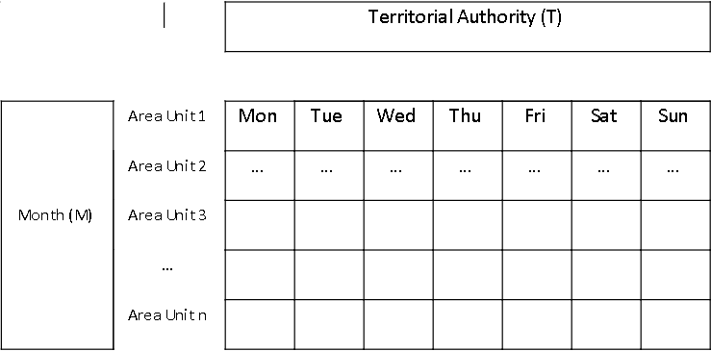
Risk Computation
DAY_AREA_CRIME_COUNT
df.groupby(['MONTH', 'DAY', 'AREA_0']).size().to_frame('DAY_AREA_CRIME_COUNT')
Notes:
Wisanu

Slide 23
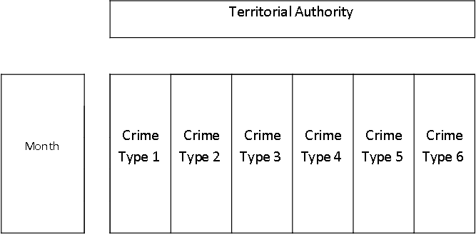
Risk Computation
MONTH_AREA_CRIME_TYPE_COUNT
df.groupby(['MONTH', 'AREA_1', 'CRIME_TYPE']).size().to_frame('MONTH_AREA_CRIME_TYPE_COUNT')
Notes:
Wisanu

Slide 24
Verify the formula
Total Crime(M,T) = Crime Count Grouped by Month and Territorial Authority
Total Crime(M,T) = Sum of Everyday Crime Count of All Area Unit
Total Crime(M,T) = Sum of Crime Count by Crim Type

Slide 25
Risk Computation: Ratio
DAY_AREA_CRIME_COUNT
DAY_AREA_CRIME_RATIO =
MONTH_AREA_CRIME_RATIO =
CRIME_RATIO =
MONTH_AREA_CRIME_COUNT
MONTH_AREA_CRIME_TYPE_COUNT
MONTH_AREA_CRIME_COUNT
DAY_AREA_CRIME_RATIO x MONTH_AREA_CRIME_RATIO

Slide 26
Risk Computation: Rank & Risk
CRIME_RATIO RANK RISK
In a specific Area Unit
Risk = 0
1
2
0
Percentile
1
0.3
0.7

Slide 27
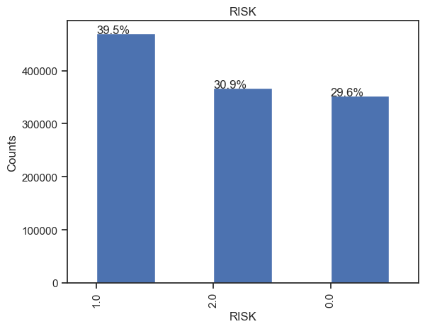
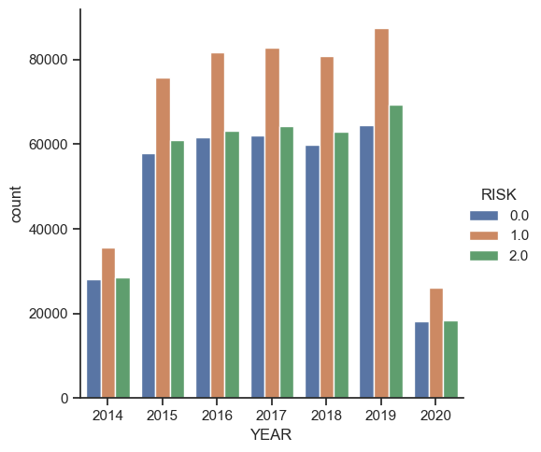
Risk Computation: Code & Result
CRIME_RATIO RANK RISK
df["CRIME_RANK"] = df.groupby(["AREA_0"])["CRIME_RATIO"] .rank(method='max', pct=True)
df.loc[(df['CRIME_RANK'] >= 0.7), 'RISK'] = 2
df.loc[((df['CRIME_RANK'] >= 0.3) & (df['CRIME_RANK'] < 0.7)), 'RISK'] = 1
df.loc[(df['CRIME_RANK'] < 0.3), 'RISK'] = 0

Slide 28
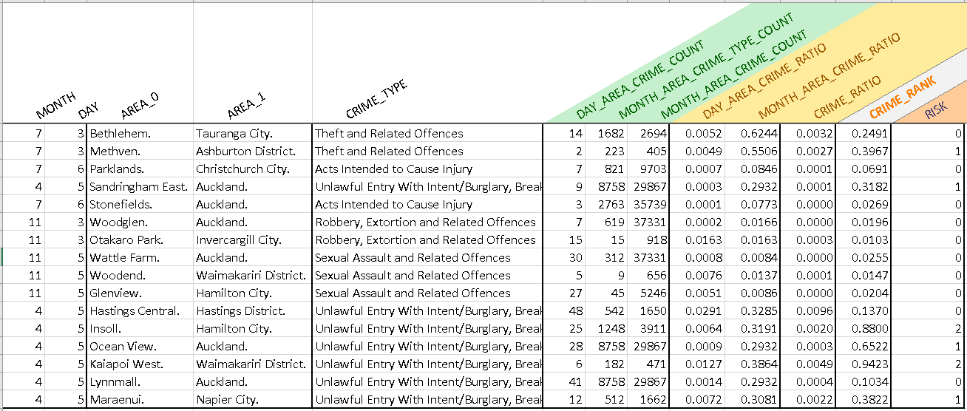
Risk Computation: Export a new dataset
Ready for the predictive modelling!

Slide 29
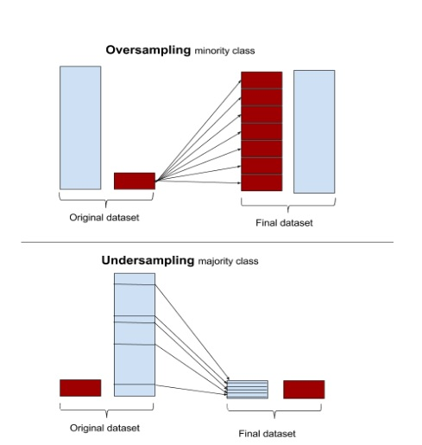
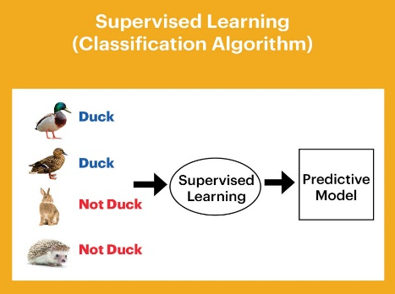

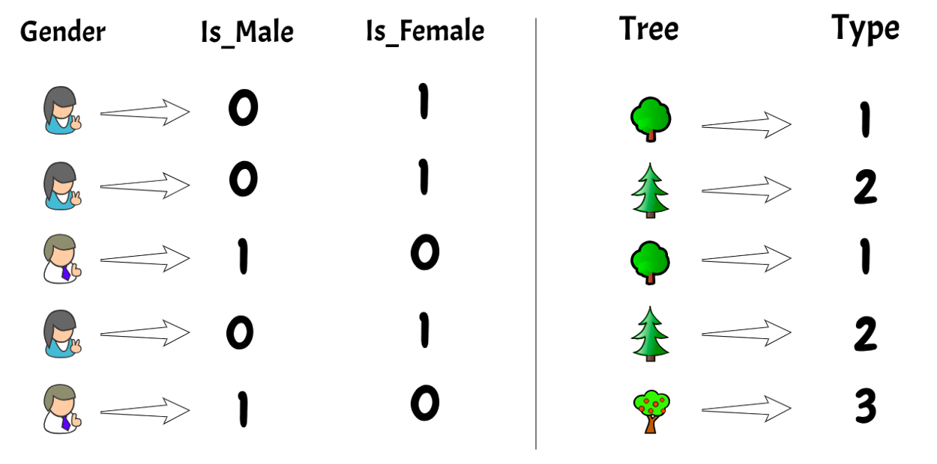
Predictive Modelling
Read dataset
Declare feature & target vars.
Encode categorical features
Oversampling data (SMOTE)
Feature Engineering
Features | Target
MONTH DAY AREA_0 AREA_1 QUARTER HOUR_PARTITION WEAPON_TYPE CRIME_TYPE 3_DAY_AREA_CRIME_MEAN | RISK
Notes:
Final scores Deep learning scores – briefly explain / see efficiency
CSV Icons by https://www.flaticon.com/authors/freepik
Encode features image by https://medium.com/analytics-vidhya/types-of-categorical-data-encoding-schemes-a5bbeb4ba02b
Oversampling image by https://stats.stackexchange.com/questions/351638/random-sampling-methods-for-handling-class-imbalance
Train/test set image by https://towardsdatascience.com/train-test-split-and-cross-validation-in-python-80b61beca4b6
Train models image by https://www.datanami.com/2018/09/05/how-to-build-a-better-machine-learning-pipeline/
K-Fold image by https://scikit-learn.org/stable/auto_examples/model_selection/plot_cv_indices.html
Evaluate result image by https://www.svds.com/the-basics-of-classifier-evaluation-part-1/
Log Loss image by https://towardsdatascience.com/understanding-binary-cross-entropy-log-loss-a-visual-explanation-a3ac6025181a penalize bad predictions

Slide 30
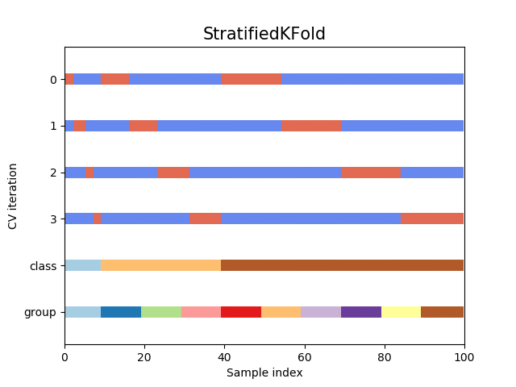
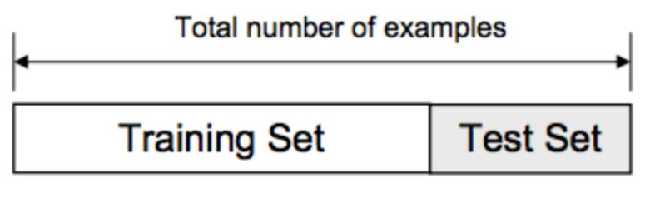
Predictive Modelling
Read dataset
Declare feature & target vars.
Encode categorical features
Oversampling data (SMOTE)
Split train/test set
Train/test models
Cross-validation
Notes:
Final scores Deep learning scores – briefly explain / see efficiency
CSV Icons by https://www.flaticon.com/authors/freepik
Encode features image by https://medium.com/analytics-vidhya/types-of-categorical-data-encoding-schemes-a5bbeb4ba02b
Oversampling image by https://stats.stackexchange.com/questions/351638/random-sampling-methods-for-handling-class-imbalance
Train/test set image by https://towardsdatascience.com/train-test-split-and-cross-validation-in-python-80b61beca4b6
Train models image by https://www.datanami.com/2018/09/05/how-to-build-a-better-machine-learning-pipeline/
K-Fold image by https://scikit-learn.org/stable/auto_examples/model_selection/plot_cv_indices.html
Evaluate result image by https://www.svds.com/the-basics-of-classifier-evaluation-part-1/
Log Loss image by https://towardsdatascience.com/understanding-binary-cross-entropy-log-loss-a-visual-explanation-a3ac6025181a penalize bad predictions

Slide 31
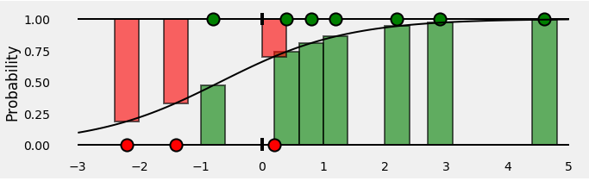
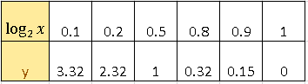
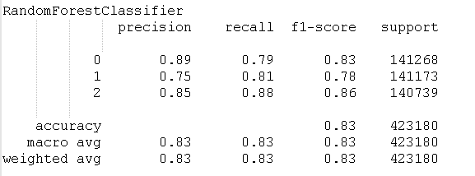
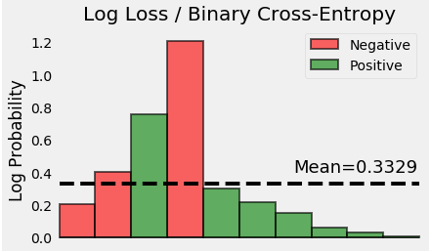
Predictive Modelling
Read dataset
Declare feature & target vars.
Encode categorical features
Oversampling data (SMOTE)
Split train/test set
Train/test models
Cross-validation
Evaluate result
Classification report
Log Loss
Notes:
Final scores Deep learning scores – briefly explain / see efficiency
CSV Icons by https://www.flaticon.com/authors/freepik
Encode features image by https://medium.com/analytics-vidhya/types-of-categorical-data-encoding-schemes-a5bbeb4ba02b
Oversampling image by https://stats.stackexchange.com/questions/351638/random-sampling-methods-for-handling-class-imbalance
Train/test set image by https://towardsdatascience.com/train-test-split-and-cross-validation-in-python-80b61beca4b6
Train models image by https://www.datanami.com/2018/09/05/how-to-build-a-better-machine-learning-pipeline/
K-Fold image by https://scikit-learn.org/stable/auto_examples/model_selection/plot_cv_indices.html
Evaluate result image by https://www.svds.com/the-basics-of-classifier-evaluation-part-1/
Log Loss image by https://towardsdatascience.com/understanding-binary-cross-entropy-log-loss-a-visual-explanation-a3ac6025181a penalize bad predictions

Slide 32
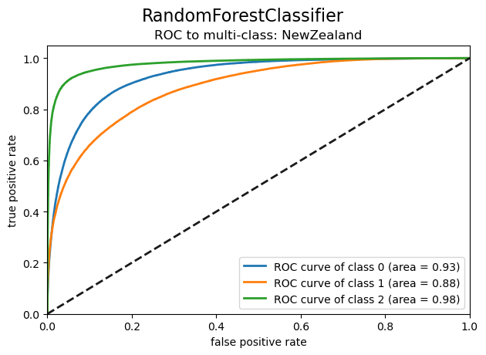
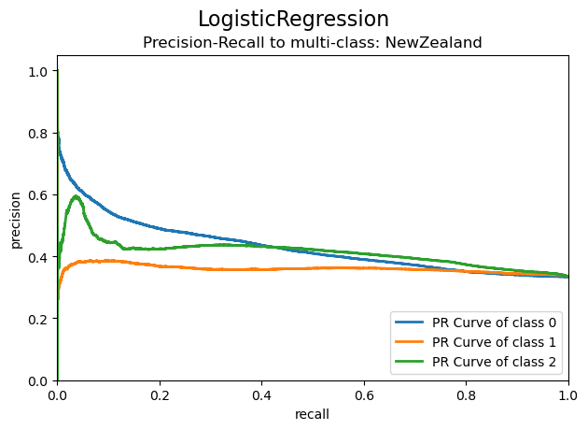
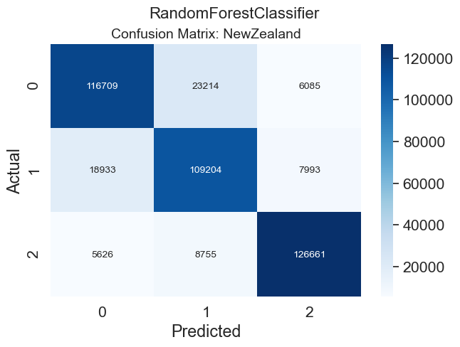
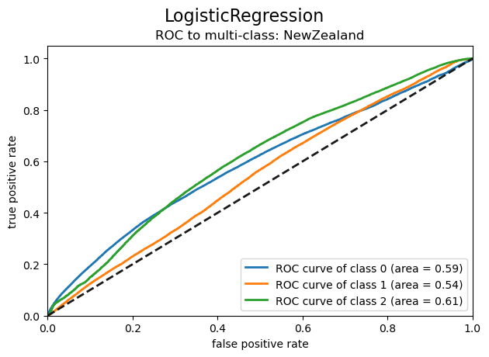
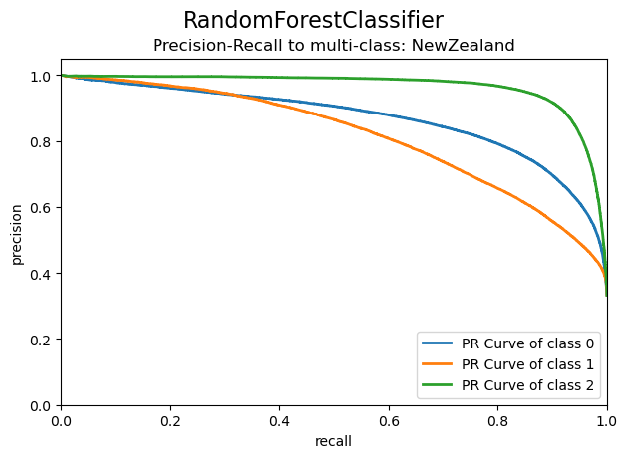
Predictive Modelling
Read dataset
Declare feature & target vars.
Encode categorical features
Oversampling data (SMOTE)
Split train/test set
Train/test models
Cross-validation
Evaluate result
Classification report
Log Loss
Visualize result
Confusion matrix
ROC curve
PR curve
Notes:
Final scores Deep learning scores – briefly explain / see efficiency
CSV Icons by https://www.flaticon.com/authors/freepik
Encode features image by https://medium.com/analytics-vidhya/types-of-categorical-data-encoding-schemes-a5bbeb4ba02b
Oversampling image by https://stats.stackexchange.com/questions/351638/random-sampling-methods-for-handling-class-imbalance
Train/test set image by https://towardsdatascience.com/train-test-split-and-cross-validation-in-python-80b61beca4b6
Train models image by https://www.datanami.com/2018/09/05/how-to-build-a-better-machine-learning-pipeline/
K-Fold image by https://scikit-learn.org/stable/auto_examples/model_selection/plot_cv_indices.html
Evaluate result image by https://www.svds.com/the-basics-of-classifier-evaluation-part-1/
Log Loss image by https://towardsdatascience.com/understanding-binary-cross-entropy-log-loss-a-visual-explanation-a3ac6025181a penalize bad predictions

Slide 33

Predictive Modelling & Results
 | train=70 / test=30 |  | K-Fold CV. (k=5) |  | K-Fold CV. (k=10
algorithm | accuracy | log_loss | accuracy | log_loss | accuracy | log_loss
LogisticRegression | 0.4 | 1.09 | 0.39 | 1.09 | 0.37 | 1.09
GaussianNB | 0.37 | 1.12 | 0.36 | 1.12 | 0.34 | 1.12
KNeighbors (k=12) | 0.77 | 1.03 | 0.78 | 1.04 | 0.79 | 1.04
DecisionTree (max_depth=20) | 0.76 | 1.81 | 0.75 | 1.81 | 0.75 | 1.7
XGBoost (max_depth=12) | 0.84 | 0.49 | 0.84 | 0.49 | 0.83 | 0.5
RandomForest (max_depth=20) | 0.84 | 0.51 | 0.83 | 0.52 | 0.83 | 0.52
 | epoch=32 |  | epoch=64
 | accuracy | loss | accuracy | loss
Deep Learning: TensorFlow Batch size: 64 | 0.77 | 0.5 | 0.79 | 0.46
Save the models!
Notes:
Final scores Deep learning scores – briefly explain / see efficiency
Icons made by https://www.flaticon.com/authors/smashicons

Slide 34
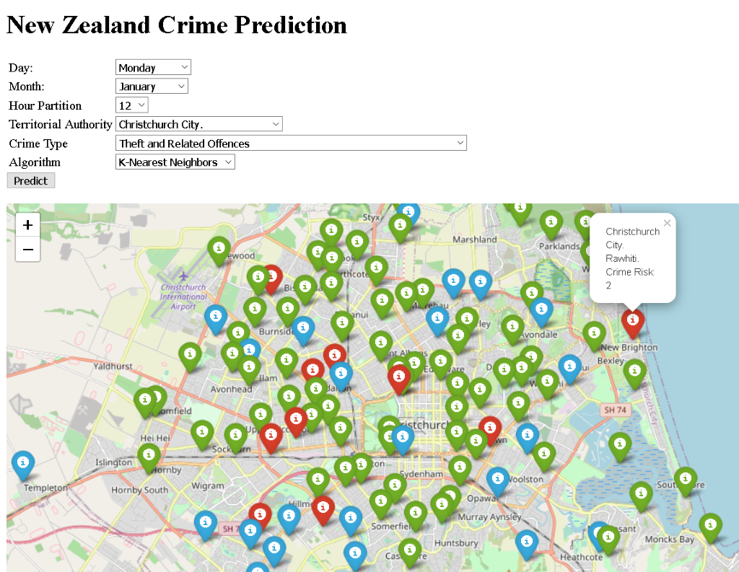
Application User Interface
Notes:
Link: http://localhost:5000
Interaction
Time:

Slide 35
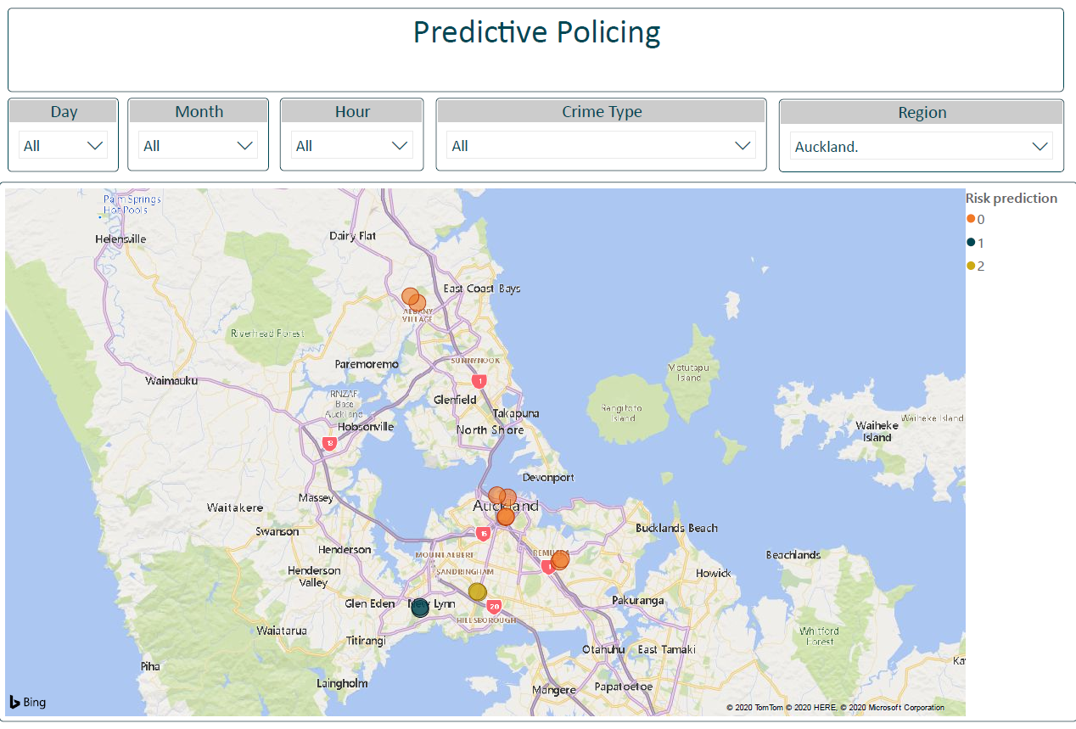
Integrate with Power BI

Slide 36
Future Works
Model
User Interface
Try different algorithm based on requirements
Create a separate model for specific crime types.
Create a model for specific time and location.
Build a web form that stores selected user data in a CSV file and load the CSV file as an input file in a power bi to visualize predicted result on map.
Notes:
Conclusion
Summarize
Hows our Experience

Slide 37
Thank you

Slide 38
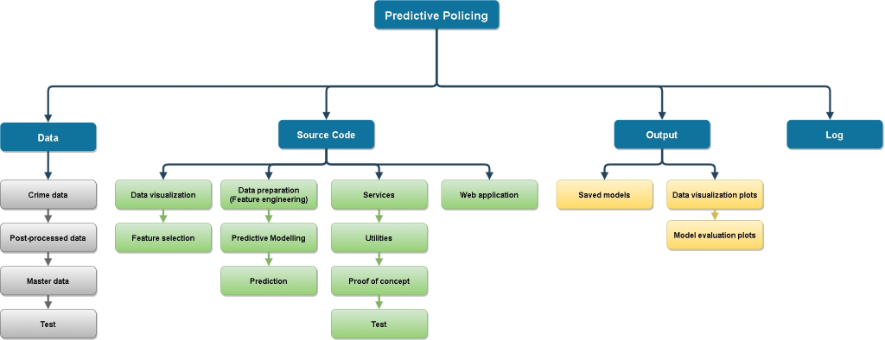
Workspace Structure

Slide 39
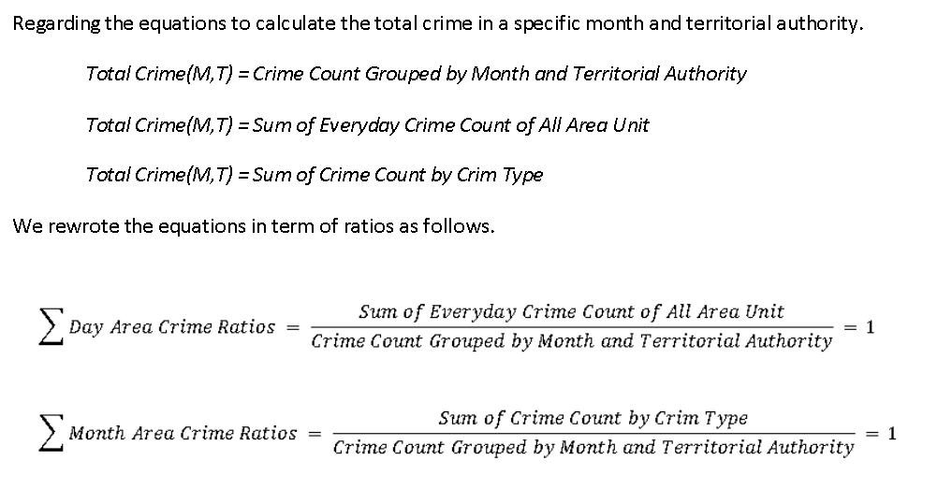
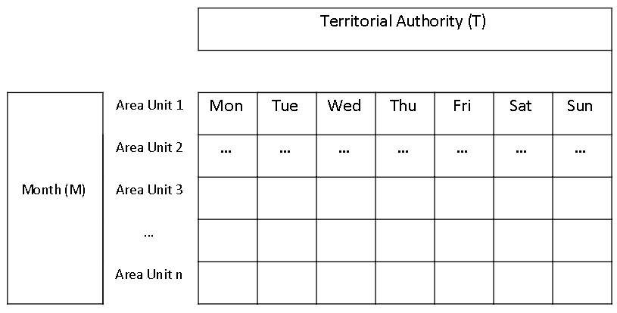
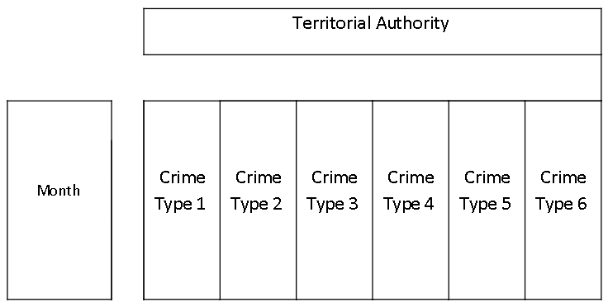
Unit Testing: Verify the formula
Total Crime(M,T)
Total Crime(M,T)
Total Crime(M,T)
Total Crime(M,T)

Slide 40
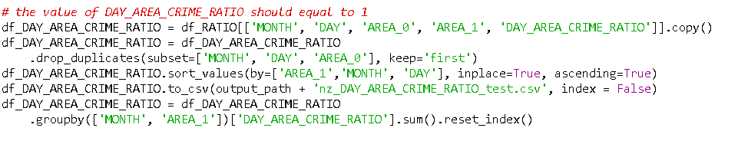
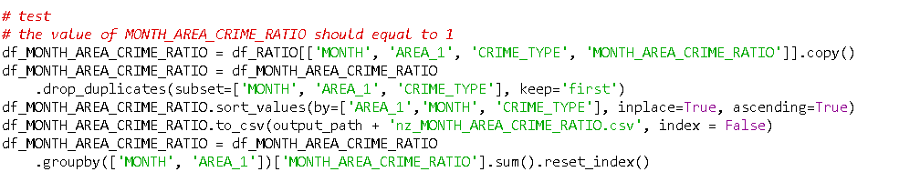


Unit Testing: Verify the formula

